Slide 1
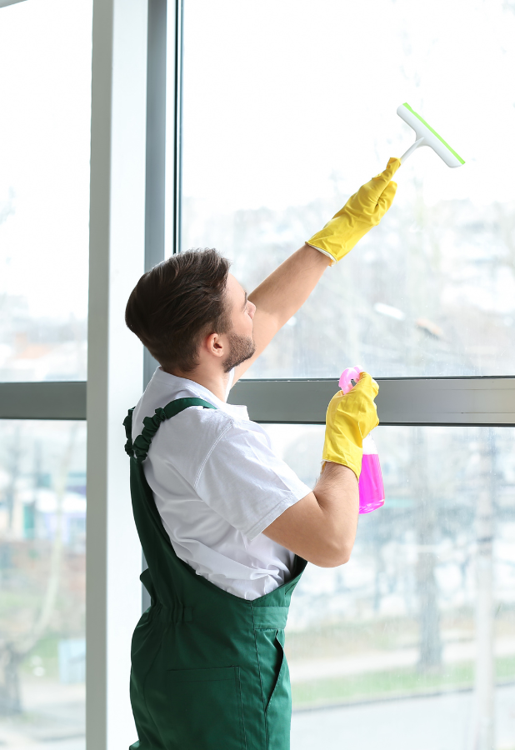

DAYTIME CLEANING IN PRACTICE:
a new reality for the European cleaning industry
27 June 2023 | Residence Palace, Brussels

Slide 2


Welcome
with Matteo Matarazzo, Director General, EFCI

Slide 3



Interact with us on socials
@_EFCI_
EFCI

Slide 4
WELCOME
Pina Picierno, MEP, Vice-President, European Parliament, S&D
Video available here

Slide 5
WELCOME
Sylvie Brunet, MEP, EMPL Committee, Renew Europe
Video available here

Slide 6
WELCOME
Svenja Hahn, MEP, IMCO Committee, Renew Europe
Video available here

Slide 7
Opening remarks
Daytime cleaning for a new visibility of the sector

Slide 8
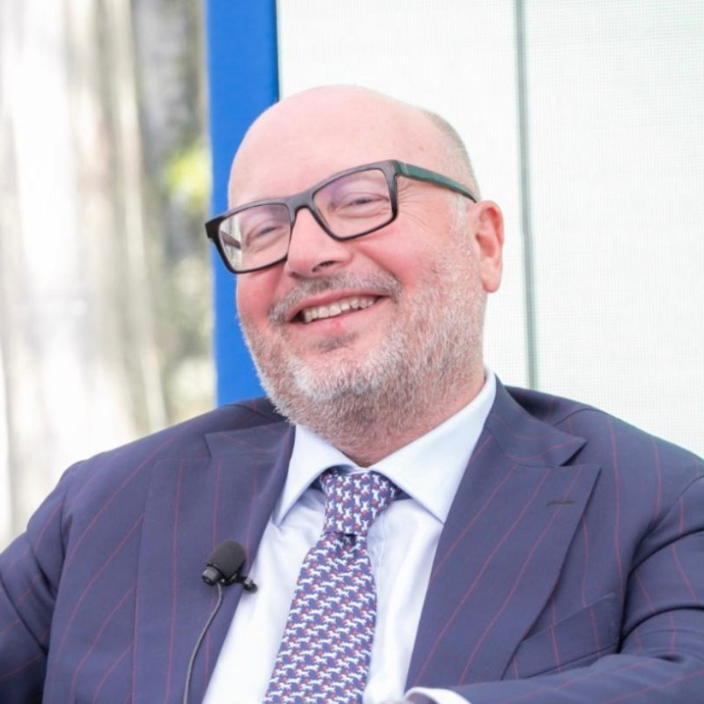
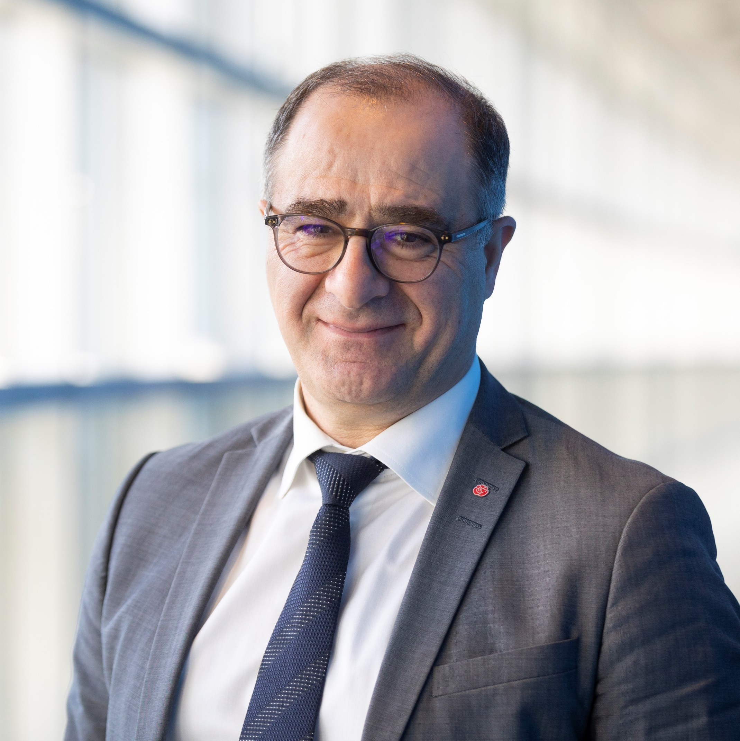
Opening remarks
Daytime cleaning for a new visibility of the sector
Ilan De Basso
MEP, European Parliament
EMPL Committee
Lorenzo Mattioli
President, EFCI

Slide 9
Technical Presentation
Understanding daytime cleaning, co-activity
and continuity of work

Slide 10
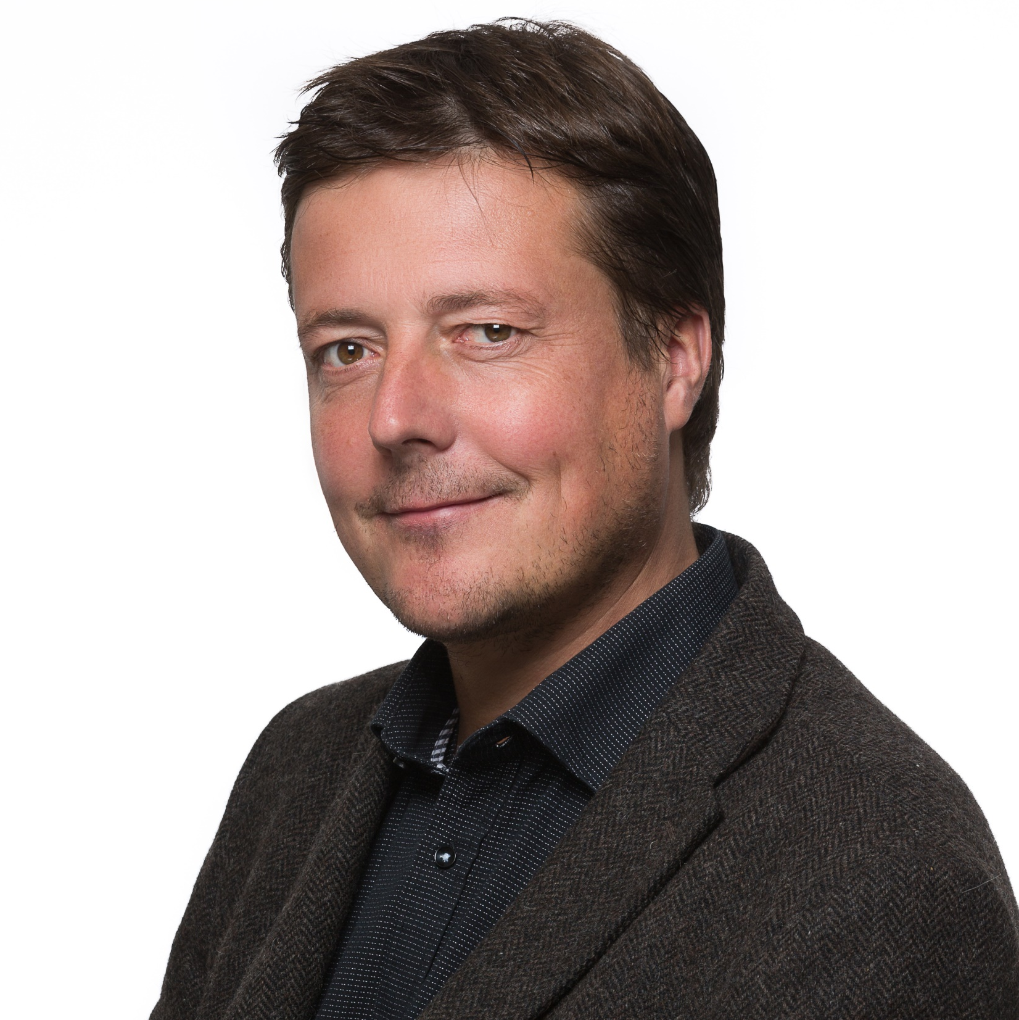
Technical Presentation
Understanding daytime cleaning, co-activity and continuity of work
Marc Guerrien
Project Manager, FARE Propreté
France

Slide 11


Day-time cleaning, coactivity and continuity of work : undestanding and implementing
Brussels, 27 June 2023

Slide 12
Agenda
The cleaning sector and the consequences of work organization
Continuous and/or daytime work: what are we talking about?
The effects for all parties
Barriers to organizational change and how to overcome them
Methodology and principles of implementation: 4 main phases to follow for a successful organizational change

Slide 13
What are the consequences of the organization of work in staggered/fragmented hours?

Slide 14
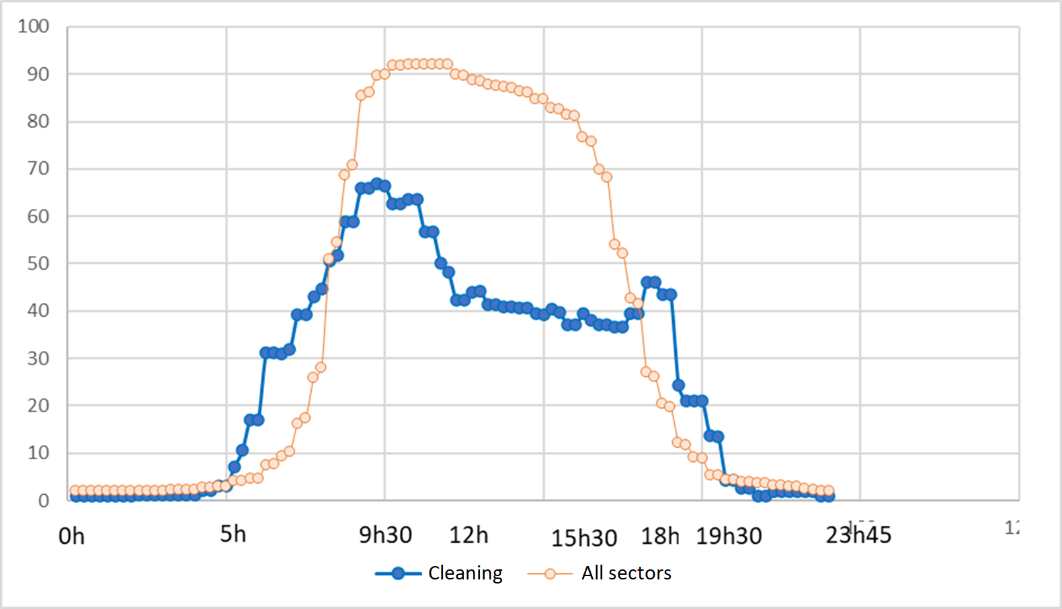
The over-representation of the working time of cleaning employees between 5:30 am. and 8 am and between 5:30 pm and 9 pm
At 6 am, 31% of cleaning employees are at work, compared to 7% for all employees in all sectors.
Source : Enquête Conditions de Travail (DARES 2019), traitement F-X Devetter.

Slide 15
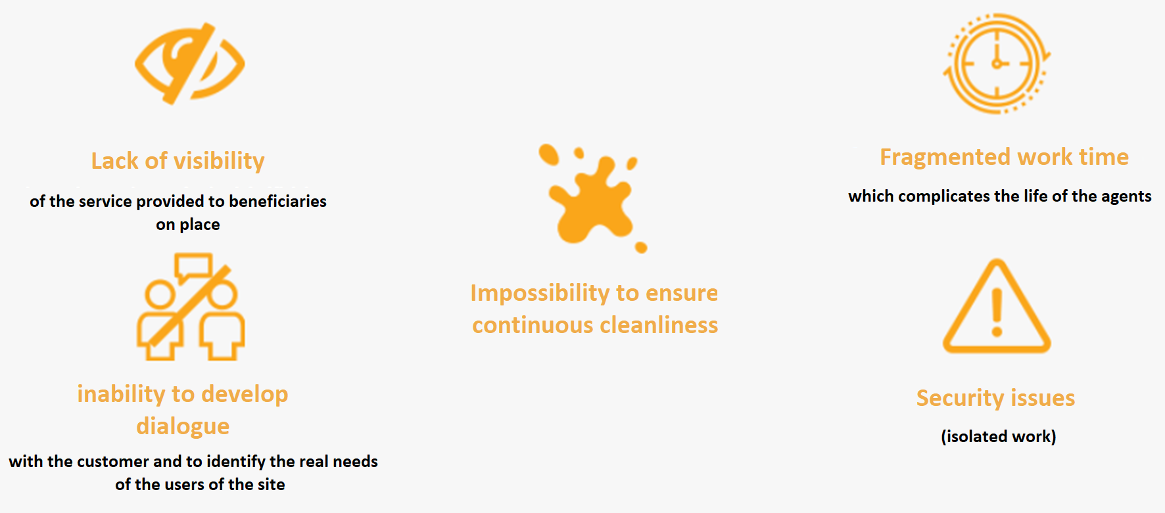
The limits of staggered work organization

Slide 16
Continuous and/or daytime work

Slide 17

Definition of continuous and/or daytime work
*
We call continuous and/or daytime work the interventions of the cleaners taking place mainly during the day, rather than in staggered hours. They thus make it possible to ensure the continuity of their working time, rather than its division, over time slots compatible with family and social life. This organization generally leads the cleaning employees to work at the same time as the users of the premises, beneficiaries of the service.
Definition of the territorial group Continuous work and/or Day of Rennes

Slide 18

A « win-win » solution for all the stakeholders
The results of studies and evaluations show that continuous and/
or daytime work is not just a question of shifting schedules.
It is a concrete commitment to social responsibility,
and it is also an evolution of the service and multiple benefits for the client
Engagement concret de responsabilité sociale, c’est aussi une évolution du service et de multiples bénéfices pour l’organisation cliente et pour l’ensemble des parties prenantes.

Slide 19
A « win-win » solution
For the employees
Possibility of increasing working time: in slightly more than one out of two establishments (53%) the switch to daytime/continuous work results in an increase in the working time of employees
More continuous schedules
An easier family and social life
More safety with in particular the reduction of lone working
Easier use of public transport
Better recognition
95%
of employers have found that agents feel more recognized in their work when it is continuous and during the day.
Source: Pôle Etudes R&D, le Monde de la Propreté, Amnyos, BVA.

Slide 20
A « win-win » solution
For the cleaning companies
92 %
of companies that have switched to daytime/continuous work are satisfied
Conditions of intervention that facilitate the recruitment,
retention and upskilling of agents
A follow-up of the activity of the agents and a facilitated
customer relationship
Reducing the number of agents isolated on site
Facilitation of continuing education
A reduction in absenteeism and turnover
Highlighting a service logic, centered on uses (BtoBtoU)
37 %
of companies observe
a drop in turnover
24 %
of companies observe
a drop in abseneeism
Source: Pôle Etudes R&D, le Monde de la Propreté, Amnyos, BVA.

Slide 21
Contributions of continuous and/or daytime work compared to staggered hours (for cleaning companies)
Promote continuous cleanliness at the customer site
Better quality of service
More reactivity with a faster response to the unexpected
Better identification of needs and a service more suited to usage
More productivity
More customer loyalty
Possibility of offering additional services
Promoting a concrete CSR commitment

Slide 22
A « win-win » solution
For the clients and the beneficiaries of the service (users)
Better visibility of the service performed
An increased human presence and the possibility of a real-time
response, particularly to unforeseen events
A cleaning service continuously adjusted according to
the rhythms of life and uses within your work environment
The maintenance of a more trusting and constructive relationship
between those who provide the service and those who benefit from it
Energy savings (lights), reduction of professional risks (isolated work)
and better security of premises (closing after office hours)
93 %
of customers believe that the trust between company and customer is strengthened
81 %
of customers surveyed report better identification of needs
68 %
of customers see faster responses to the unexpected
Promoting a concrete commitment to social responsibility
Source: Pôle Etudes R&D, le Monde de la Propreté, Amnyos, BVA.

Slide 23
Benefits perceived by customers
Compared to staggered working hours, would you say that continuous daytime work allows:
Better quality of service
More reactivity with a faster response to the unexpected
Better identification of needs and a service more suited to usage
Possibility of making adjustments and benefiting from additional services
Reductions in energy consumption
Facilitation of site security access and management
Promoting a concrete CSR commitment
Source: Pôle Etudes R&D, le Monde de la Propreté, Amnyos, BVA.

Slide 24
Satisfaction rate of clients who have implemented it
Neutral
Mostly satisfied
Fully satisfied

Slide 25
A « win-win » solution
For society and territory
Greater social cohesion
Access to employment is compatible with public transport schedules:
the use of the car can be reduced
Schedules are more compatible with the employment of people in a situation
of social fragility and integration
The schedules are compatible with the opening of nurseries and schools
Source: Pôle Etudes R&D, le Monde de la Propreté, Amnyos, BVA.

Slide 26
Barriers to change

Slide 27
A change that is no self-évident and that is difficult to generalize
Staggered working hours: a normality difficult to deconstruct
1
The strength of habits and personal organizations
A priori reluctance of customers and persistent preconceived ideas (fear of the noise of the
vacuum cleaner, discomfort linked to co-activity, fear for reasons of confidentiality or for the
exercise of a particular activity, etc.)
2
3
Management of the complexity of multi-employment (transfer of personnel in the event
of a contract award)
Apprehension of service agents and/or users
4

Slide 28
Reasons for no-implementation for the customers
Didn't even ask the question
Other (considers technically
too difficult, user refusal, etc.)
Fear that this will disturb employees
and users
Don't have time to deal with this
The cleaning company did not offer it

Slide 29
Not engaging in change when it is undesirable
There are cases where switching to daytime is not possible and not desirable, and can even be counterproductive if forced…
Some sites, for security, privacy, layout, organization, ergonomics, or other reasons, are simply not conducive to daytime cleaning.
In these cases, we must not insist and this is the reason why restrictive legislation systematically imposing daytime work can be counterproductive: the change must be organized on a case-by-case basis in consultation with all the actors and according to the characteristics of each site.
… But in many cases the change is possible and desirable, and the reluctance can be quite easily overcome.

Slide 30
Reassure and deconscruct received ideas
"It will make noise and disturb our employees“
The cleaning agents are trained to intervene in co-activity and adapt to the actual use of the premises.
The preliminary analysis of the rhythms of activity of the premises makes it possible to identify the different times and places where it is possible to intervene in co-activity (example: intervene in the offices during a meeting or at lunchtime).
Technical improvements and progress in ergonomics are increasingly removing the difficulties generally associated with setting up co-working. Scrubber dryers and vacuum cleaners that are lighter, more manageable and quieter allow discreet interventions and generate little nuisance.

Slide 31
Reassure and deconscruct received ideas
“We receive a lot of outside audiences”
This is not a problem because the reception halls can generally be made before the arrival of the occupants and the circulations and the toilets can be made in the presence of the occupants. On the contrary, it keeps them clean continuously.
In addition, working continuously and/or during the day makes the service visible and reinforces the perception of cleanliness of the spaces. Studies have shown that this could have a favorable impact on the image of the company and enhance its CSR commitment to its partners.

Slide 32
Reassure and deconscruct received ideas
“We have a need for confidentiality in relation to our activity”
It is often possible to adapt the interventions according to the specificities of each activity. For example, this has been implemented in banks, police stations, call centers, etc.

Slide 33
Implement continuous and/or daytime work with the resources available in French
Implement continuous and/or daytime work with the resources available in French

Slide 34

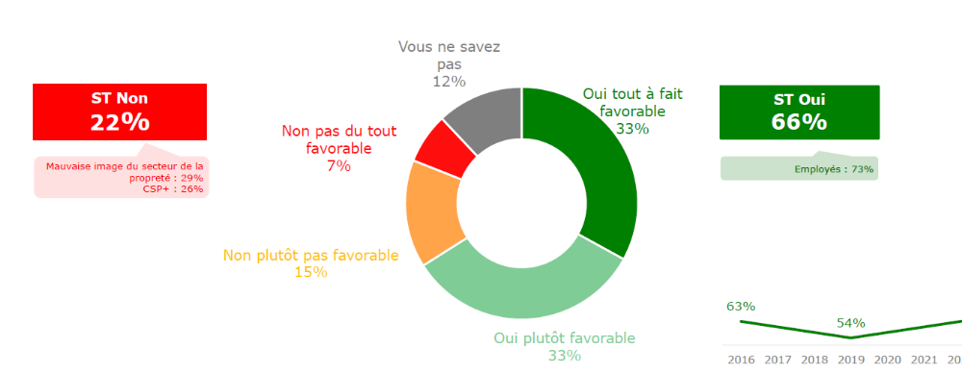
Reassure and deconscrut received ideas
“Our collaborators will oppose it”
A recent nationwide poll in France (February 2023) shows that
people are overwhelmingly in favor of daytime work
leurs locaux durant leurs horaires de travail
And after presentation of the arguments, the adhesion rises to 70%.
Source : Enquête BVA-Le Monde de la Propreté (2023)

Slide 35
Principles of implementation

Slide 36
Reassure and deconscruct received ideas
« Our activities do not allow the implementation of co-activity work on our site »
In this case, it is recommended to carry out a feasibility study to assess the times and places where it is possible to intervene in co-activity and those which it would be preferable to carry out before the opening, for example. The day pass can only be partial and not systematic.
Apart from tertiary offices, this organization has already been successfully implemented within large industrial sites, music conservatories, schools, etc., places where it was often thought a priori that this would not be possible. did not lend to it.

Slide 37
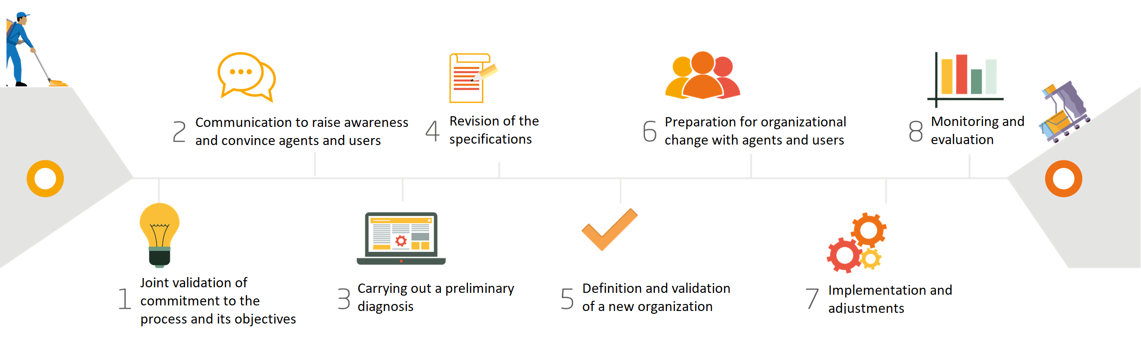
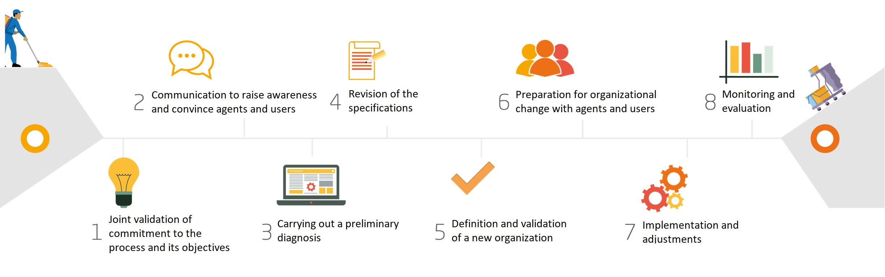
An implementation that cannot be improvised

Slide 38
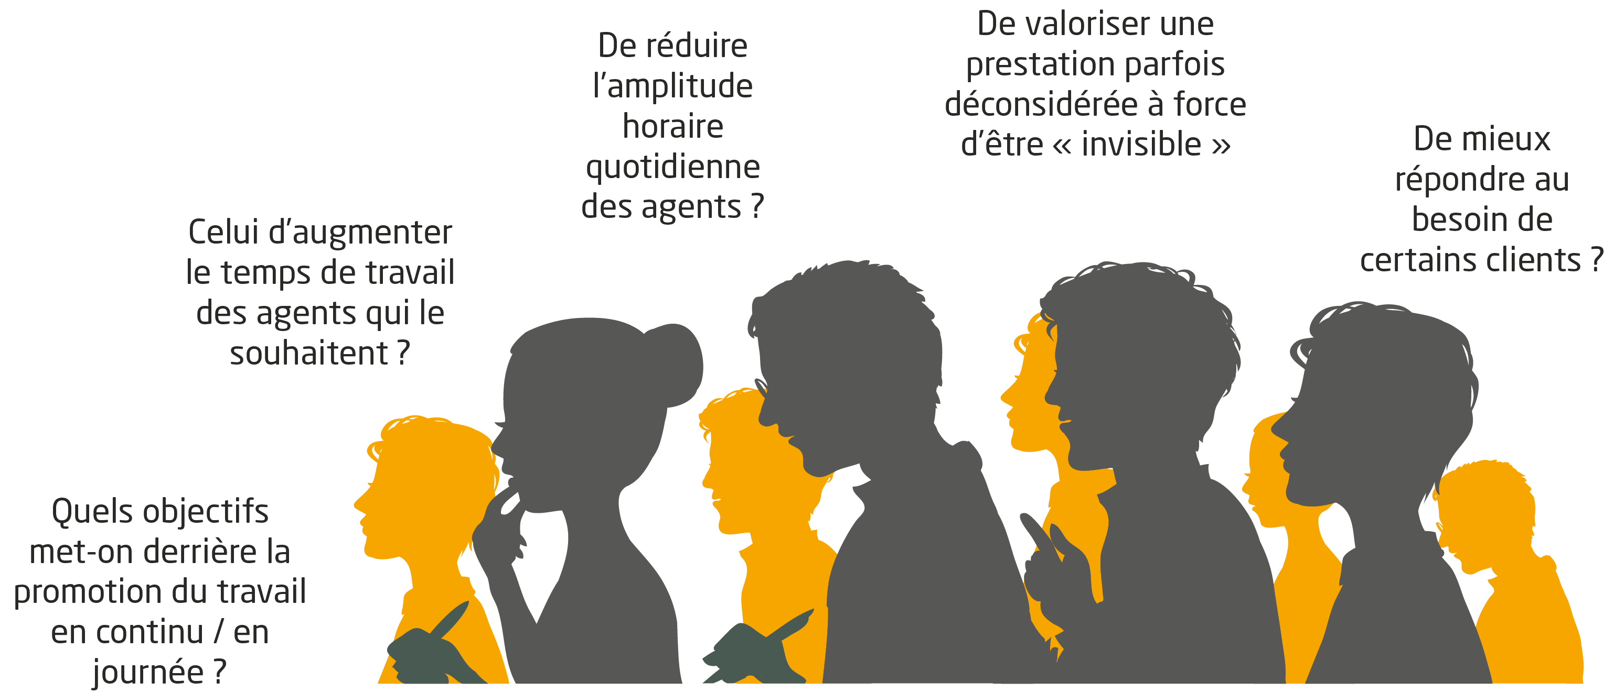
The key step: a joint feasibility study
Clearly define the goals the operational issues together
Knowing and understanding the fears and interests of the actors concerned
Communicate to explain the objectives and advantages of the approach
Evaluate the rhythms of the site and, if feasibility study is conclusive, build a new intervention plan thinking « service relationship »
Inform agents and users of the date of the change, train/prepare them for it and be attentive the first days to make any adjustments
The continuous / day shift is 50% organization and 50% communication!

Slide 39
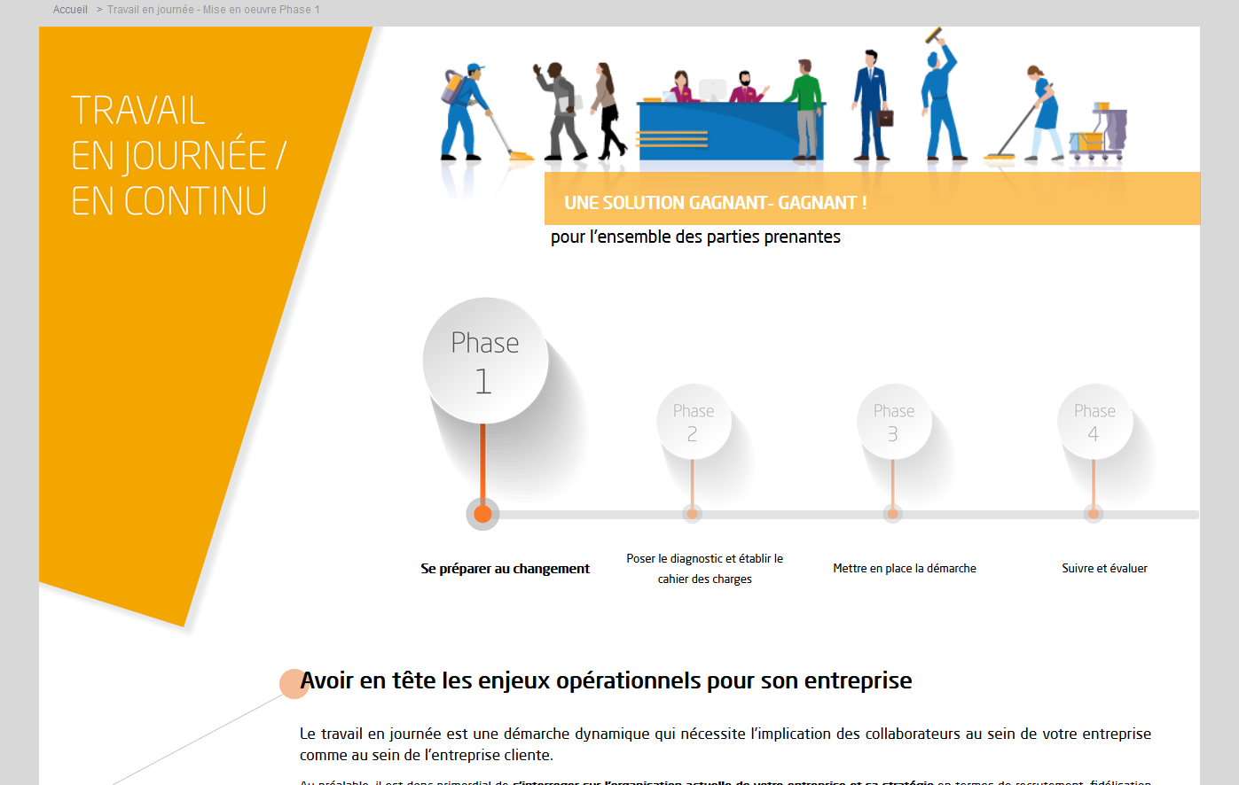

A resource space to support cleaning companies
Benefits arguments
Study results
Implementation methodology in partnership
with a client
Documents and practical tools for deployment
Video testimonials
www.monde-proprete.com/travail-en-journee

Slide 40
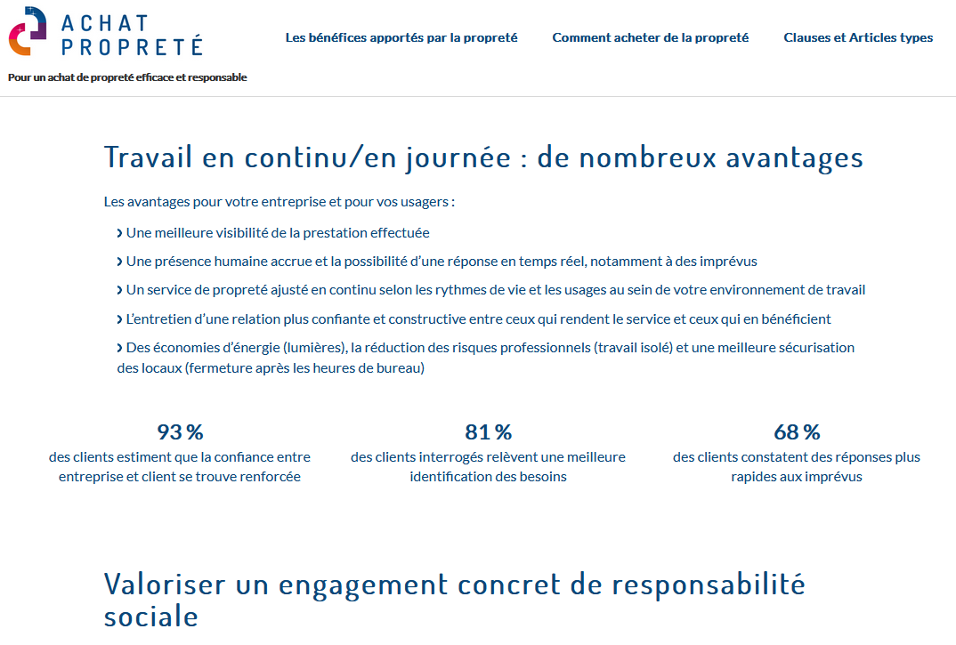

Resources for customers via “Buy cleaning” website
www.achat-proprete.com/optez-pour-le-travail-en-journee

Slide 41

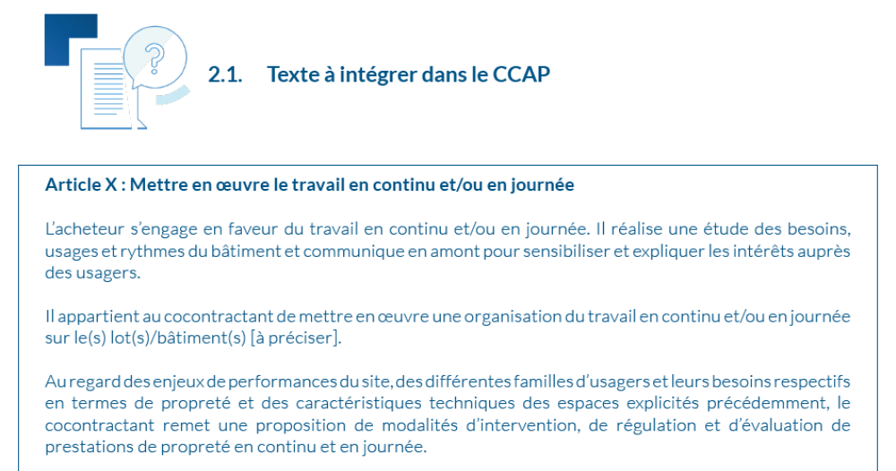
A clause for the specifications
Feedback from cleaning companies and
customers who have implemented this
organization has made it possible to
identify the key success factors and to
formulate examples of standard writing
for buyers.
www.achat-proprete.com

Slide 42
Presentation of industrial cases
Best practices from public and private sectors

Slide 43
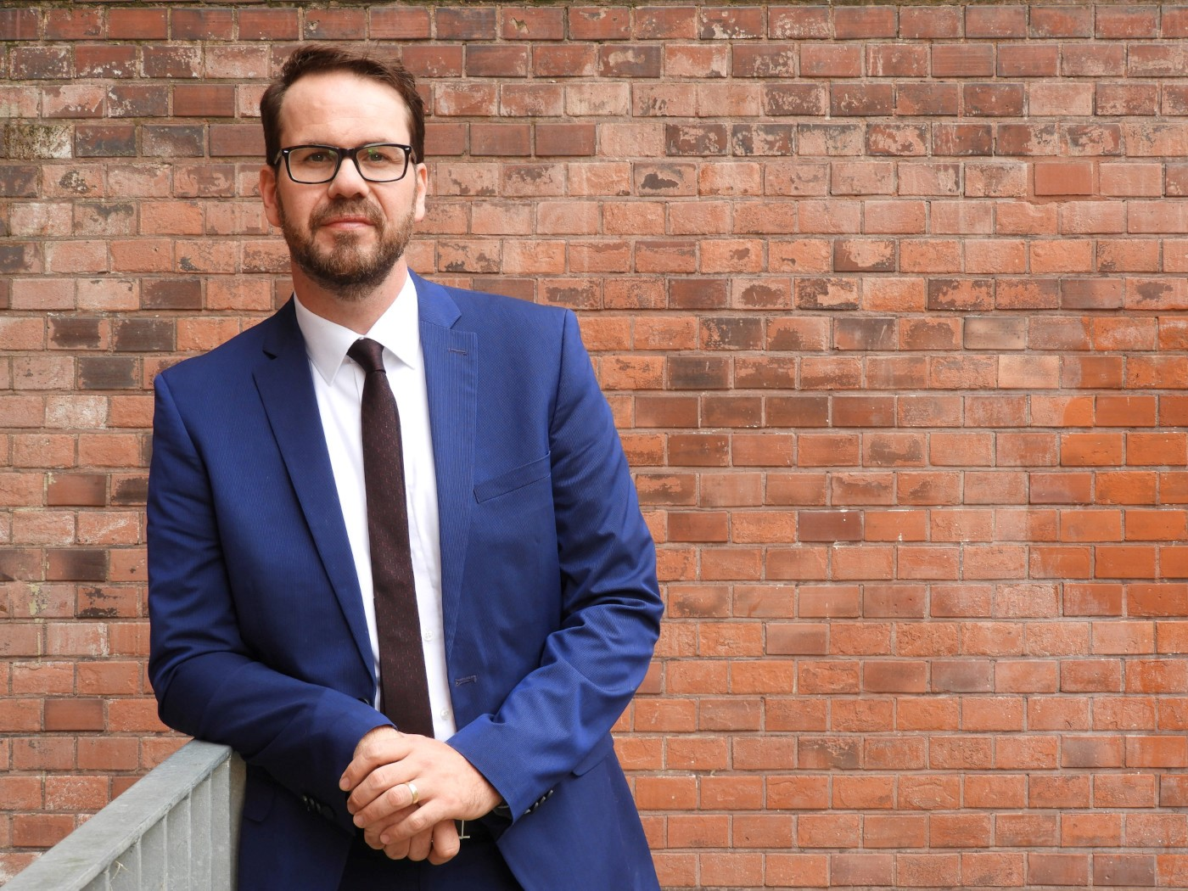
Presentation of industrial cases
Public sector: Meckelmburg-Vorpommern
Dr. Steffen Wandschneider-Kastell
Head of Facility Management
Meckelmburg-Vorpommern

Slide 44
Implementation of day cleaning in authorities of the state of Mecklenburg-Vorpommern, Germany
Brussels, 26/06/2023
Dr. Steffen Wandschneider-Kastell, LL.M
Head of the Department of Facility Management at the Ministry of Finance

Slide 45
Current status of government properties in the state “M-V“
  Management of 850 public authorities in 980 buildings
  250 state-owned properties (670 buildings) with an area of approx. 670,000 sqm
  280 rental properties (310 buildings) with an area of around 130,000 sqm
  Portfolio of police, judiciary, financial administration, various specialist administrations including ministries
  → Cleaning as part of facility management with a volume of approx. 8 million euros with a total management of approx. 50 million euros

Slide 46
Initial situation of the cleaning of the authorities
  Recording of all properties, buildings and rooms (approx. 55,000) in a computer aided facility management system (CAFM)
  for each room there is data for cleaning (450 room types, surfaces, floor covering) in the system
  Cleaning classes with defined activities (currently 62 to choose from) are set

Slide 47
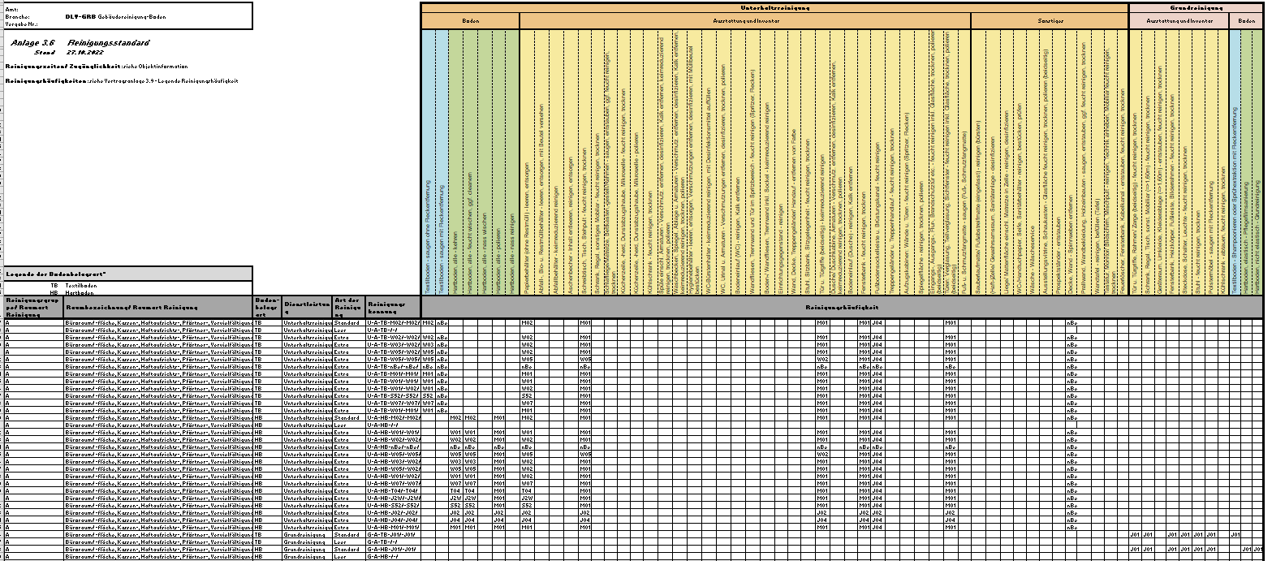
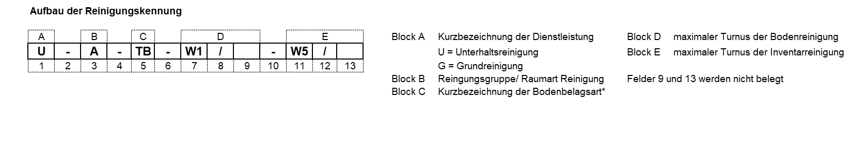

Slide 48
Timing of cleaning (until 2021)
So far, no central specifications, but wishes of the Customers (different authorities) have been implemented within the framework of tenders
Very differentiated picture In the managed properties
- partially shared services (!?) → high potential for conflict and personal stress for staff
→ Cleaning at “off-peak times” in a limited time window early in the morning (approx. 05:00 – 09:00) or in the evening (approx. 18:00 – 22:00).
Initiative of local Facility Services Industry and Association of trade union

Slide 49
Crisis as an opportunity:
Decision on piloting and implementation
Key reasons (Feb. 2021) I/II:
Increased attractiveness of building cleaning through better working conditions/hours including a better work-life balance
Effective control of the cleaning service during daily office hours

Slide 50
Key reasons (Feb. 2021) II/II:
the visibility of the daily work leads to a better mutual understanding and recognition of the work done
the opening of the window of opportunity for building cleaning also has the potential to achieve a wider range of products on the open market

Slide 51
Other reasons were investigated in a scientific study by a large FM-service company → intep-/WISAG (Oct. 2021)
https://intep.com/wp-content/uploads/2022/01/1539_08_Abschlussbericht_WISAG-Evaluation-Daycleaning_vdef.pdf (german only)
Environmental sustainability:
Climate impact, Energy consumption in building operation, Use of materials and resources, Mobility of cleaners
Economic sustainability:
Costs, Service level, Coordination, Interruptions in the workflow, Recruitment
Social sustainability:
Possibilities of appreciation, Visibility and communication, Physical and mental health, Socially acceptable working conditions, Contentment,
Social participation

Slide 52
Administrative implementation "top-down"
Binding Decree by Ministry of Finance: “Implementation of the day cleaning model for new tenders for building cleaning”
→ Central specification of an open time window (6:30 a.m. to 6:00 p.m.)
→ No obligation to clean during day-time for companies
Reversal of the “burden of justification” for Customers administrations
Exceptions: Courtrooms, Seminar rooms at schools…
But: Kitchenettes, administrative offices, toilets, corridors are possible!
Technical implementation via CAFM system
Maintenance of the cleaning time window at the level of the building
Possibility of manual correction at the level of the room

Slide 53
Experiences and outlook
Positive feedback from service providers and Customers administrations
Implementation is still ongoing due to long-term contracts (4 years)
→ M-V will continue on this path consistently

Slide 54
If you don't know the port you want to sail to, no wind is the right one for you.
Seneca
Ministry of Finance Mecklenburg-Vorpommern, Germany
Dr. Steffen Wandschneider-Kastell
Telefon +49 385 588-14400
steffen.wandschneider-kastell@fm.mv-regierung.de
www.mecklenburg-vorpommern.de

Slide 55
Presentation of industrial cases
Private sector: Bau-Rein GmbH
with Heiko Middelhuss, Facility & Maintenance Manager
Video available here

Slide 56
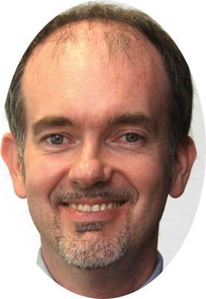

Presentation of industrial cases
Private sector: Juventus MC
Alberto Bolzonello
BIM Specialist
Juventus FC
Fulvio Berchialla
Facility & Maintenance Manager
Juventus FC

Slide 57
Daytime cleaning in practice
Juventus case study
Brussels, 27-06-2023

Slide 58
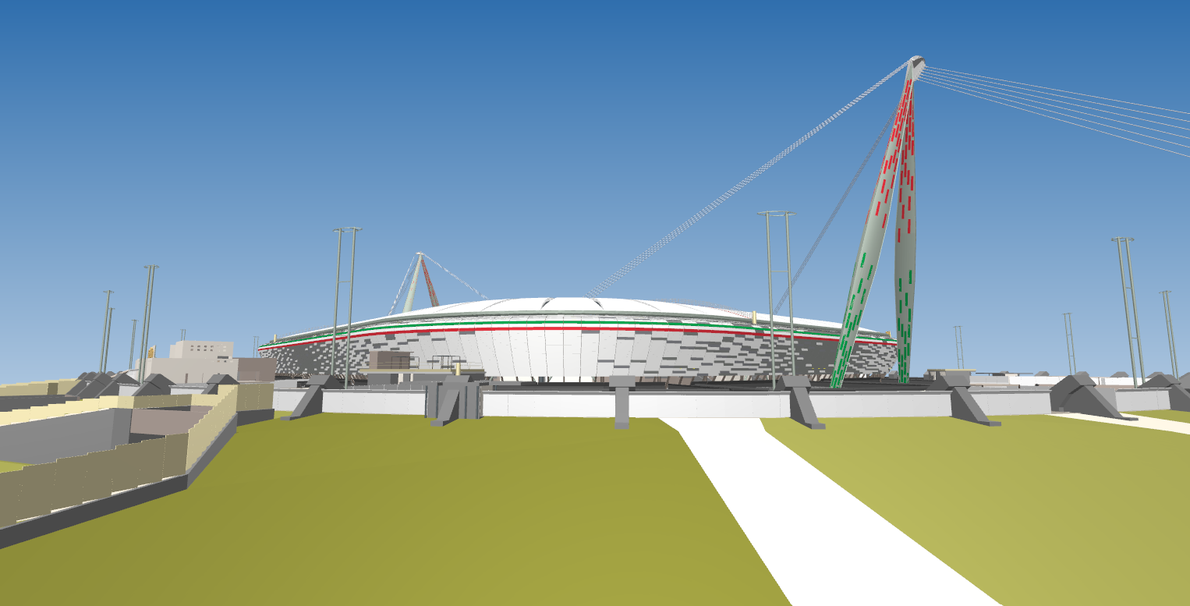
Infrastructures
Match Day
335 Total games played in almost 12 years
35 Total games played in season 21/22
(Serie A, UCL, WUCL, Nation League Final, UWCLF, Juventus Next Gen)
82% Sold Out pre-pandemic
1M Visitors pre-pandemic
No-Match-day events
Up to 130 No-Match day events per season pre-pandemic
Museum & Tour
Up to 150.000 visitors pre-pandemic

Slide 59
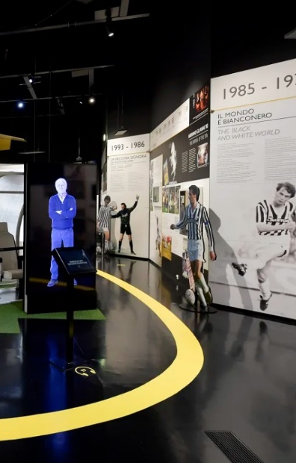
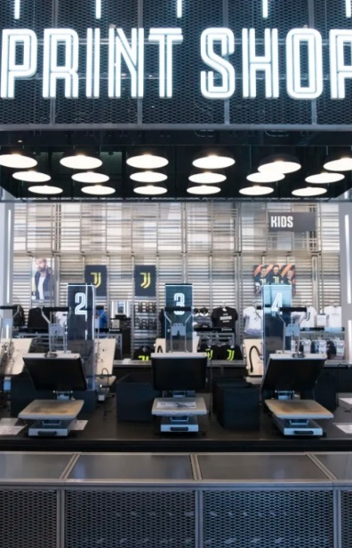
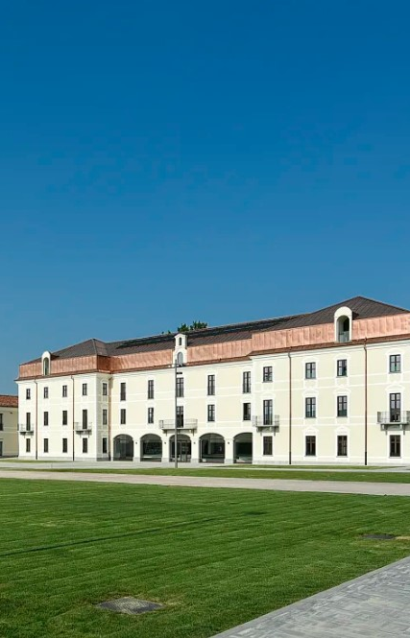
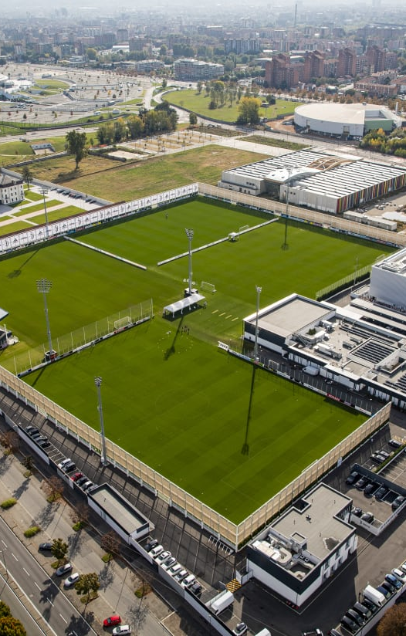
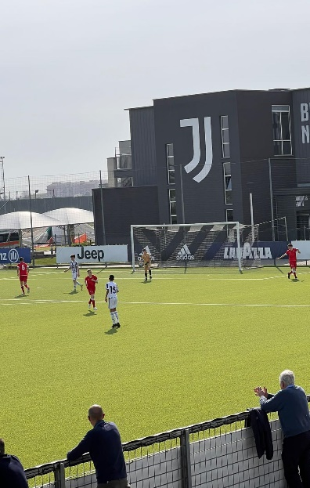
Infrastructures
Juventus Museum
Megastore + stores (MI/TO/RM)
JHQ Headquarter
JTC Training Center Continassa
JTCV Training Center Vinovo

Slide 60
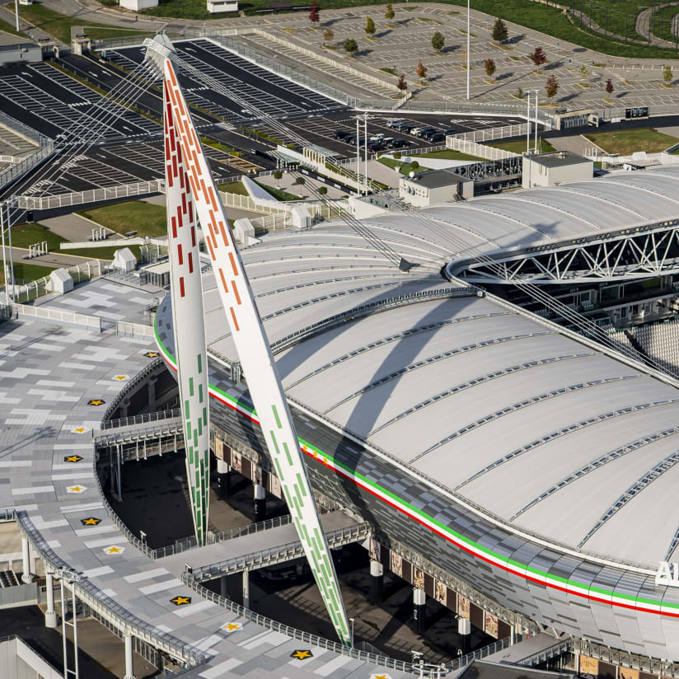
Infrastructures
Juventus’s perspective has evolved over the years, as we transition from RENTING to OWNING.
Optimizing resources and tool utilization
Increasing sustainability and ESG consciousness
Pioneering the digital transformation of Facility Management

Slide 61
The daytime cleaning at the Headquarter
Activities | Time slot | Type of spaces
Daily basic cleaning | (Mon - Fri) 06:00 – 08:00 19:00 – 22:00 | indoor and outdoor areas
Periodic cleaning | (Sat) 07:00 – 18:00 | periodic deep cleaning carried out on specific elements such as floors, windows and doors
Monitoring activities | (Mon – Fri) 09:00-17:30 | restrooms – club house – break areas – specific outdoor areas
Temperature measurement and ice formation control | (Mon - Sun) 06:30 - 07:30 | activities carried out during the winter period from November to March on specific outdoor areas

Slide 62
The daytime cleaning at the Stadium (included the Juventus Museum and Megastore)
Activities | Time slot | Type of spaces
Daily basic cleaning | (Mon - Fri) 06:00 – 13:00 | workspaces - common and break areas - outdoor areas – restrooms (near the workspaces) – specific technological spaces
Periodic cleaning | (Mon – Sat) 06:00 - 20:00 | periodic deep cleaning carried out on specific elements such as floors, windows and doors
Monitoring activities | (Mon – Sun) 09:00 - 18:00 | hospitalities and all areas involved in the Juventus tour
Temperature measurement and ice formation control | (Mon - Sun) 06:30 - 07:30 | activities carried out during the winter period from November to March on specific outdoor areas

Slide 63
The match day
The match day activities are structured as follows:
  MD-1: deep cleaning of the indoor and outdoor areas of the Stadium such as all parking lots and turnstiles, as well as all internal areas such as hospitalities, stadium seats and bathrooms
  Match day: Monitoring activities
  MD+1: in line with the specifications outlined in MD-1

Slide 64
Topics for reflection
According to the provisions of the European Commission on human rights, Juventus is ready to evaluate its supply chain from the next contractual cycle.

Slide 65
Brussels, 27-06-2023

Slide 66
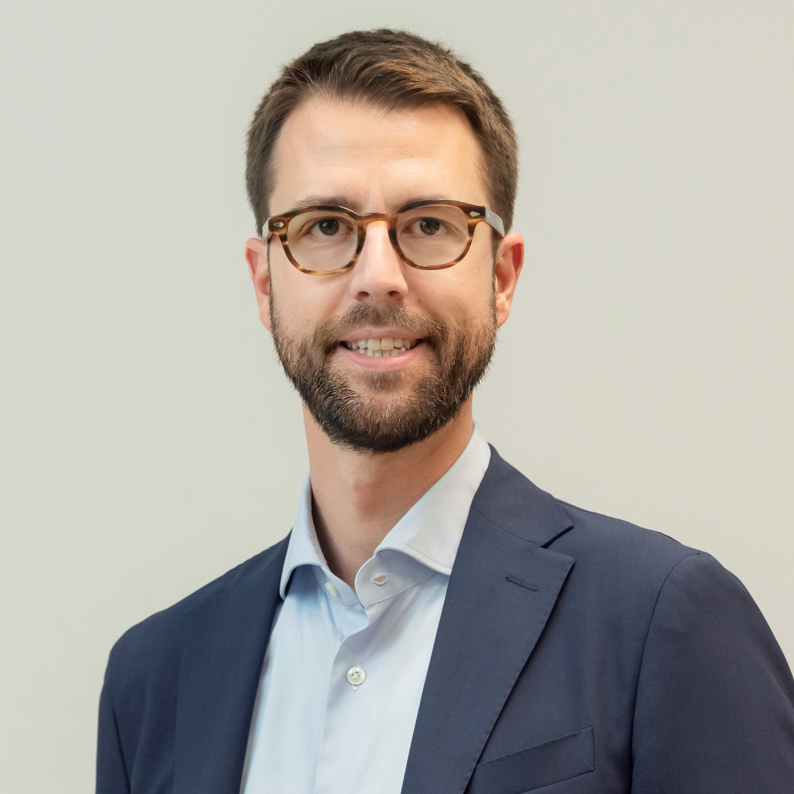
Presentation of industrial cases
Private sector: Samsic Italia SPA
Umberto Diamante
CEO & Country Manager
Samsic Italia SPA

Slide 67

Driving change
Benefits and opportunities from a daytime and continuous worktime in facility industries

Slide 68

Main objectives
  Take care of our employee’s health (psychological, physical and social)
  Re-evaluate a role that is deeply rooted in every aspect of our life and can contribute to the individual wellbeing
  Meet the client's needs

Slide 69

Not to be forgotten
There is a need to refer to a cost-benefit ratio through a strict measurement of impact gathering quantitative and qualitative data
These policies and best practices may be implemented according to:
technical-operational necessities
client’s needs
various sectors of intervention

Slide 70









Benefits for our employees
Reduced work-related stress
Easier to get to the client
Get to the client in daylight increase social security
Reduce time wasted in traffic
Enhanced work-life balance
Quality time with family and friends
Enhanced employee engagement

Slide 71




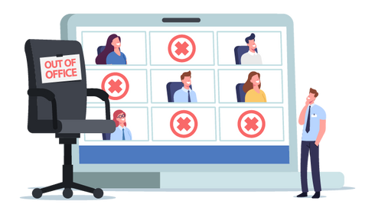


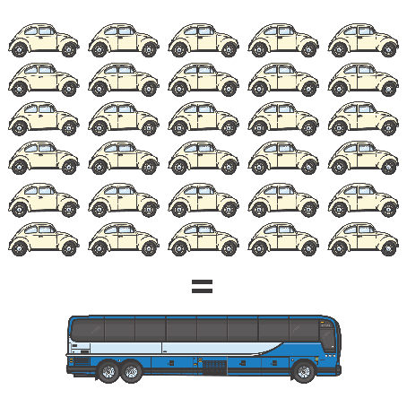
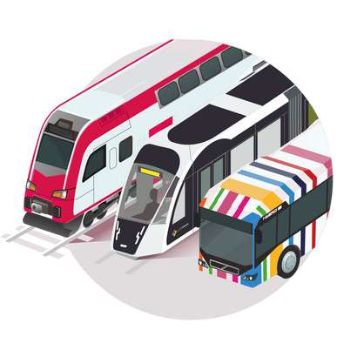
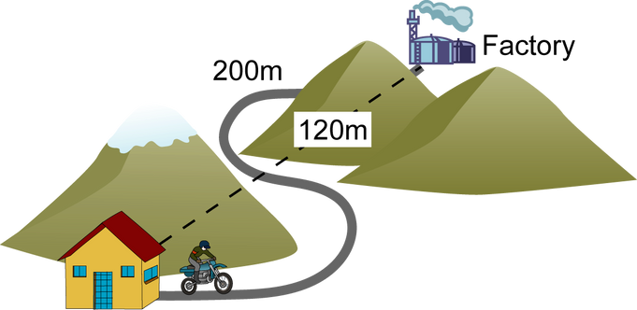
Benefits for our clients
Improved service quality
Easier and faster intervention
Reduce absenteeism
More attention to client’s needs
Protection of the environment
Opportunity to use company’s transportation for employee
Greater public transportation availability
Minimize commute distance
During daylight you don’t use the same energy than in nighttime

Slide 72
Panel Discussion
Making daytime cleaning work for all

Slide 73
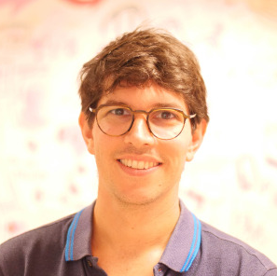

Panel Discussion
Making daytime cleaning work for all
Dr. Steffen Wandschneider-Kastell
Head of Facility Management, Germany
Lorenzo Mattioli
President, EFCI
Marc Bergfeld
Director Property Services & Unicare
UNI-Europa
Umberto Diamante
CEO & Country Manager
Samsic Italia SPA

Slide 74

Q & A

Slide 75
Closing remarks

Slide 76

Networking coffee

Slide 77

Thank you!
secretariat@efci.eu | +32 2 225 83 30 | 205, Rue Belliard 1040 Brussels | www.efci.eu

